Slide 1
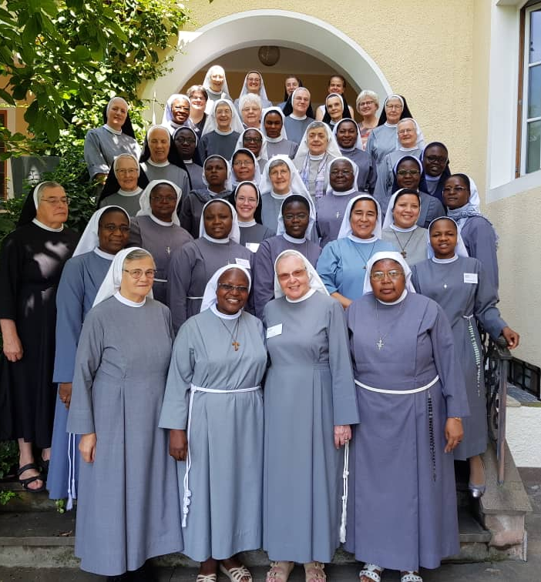
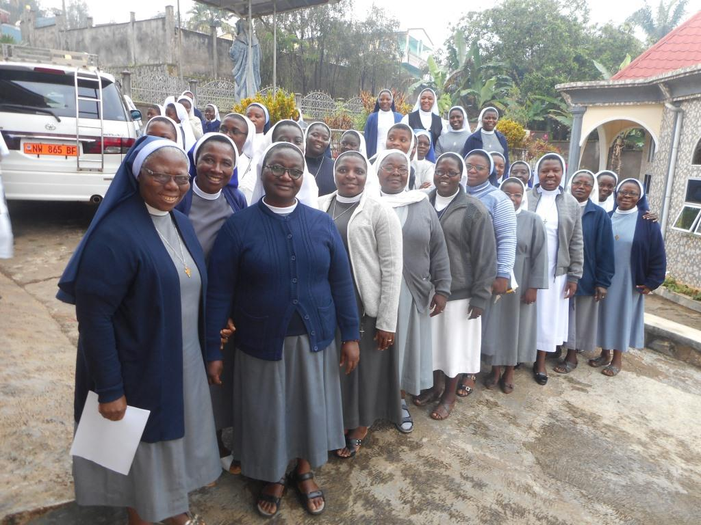
Health Services of the Tertiary Sisters of St. Francis, Cameroon
By Sr. Budzee Appolonia, CEO

Slide 2
Who are the Tertiary Sisters of St. Francis (TSSF)
Founded in Brixen by Venerable Maria Hueber in 1700
First five missionaries sent to Cameroon (Shisong) in 1935
Response to the numerous social needs: healthcare, education, orphanage
New foundations in Cameroon: Njinikom (1953) Bafut (1963) etc

Slide 3
TSSF IDENTITY
Mission: To be an empowering wherever we are.
Vision: to be committed and rooted in love for the welfare of God’s people.
Charism: pray, be attentive and responsive to the will of God in the signs of the times.
Strategic goal: to offer quality services in the apostolate through efficient and effective management practices which enhance self-reliance, drawn from community life and holistic formation

Slide 4
TSSF PRESENCE IN THE WORLD
Europe: Italy and Austria
Latin America: Bolivia
Africa: Cameroon, Nigeria, Republic of Central Africa, Democratic Republic of Congo and Morroco.

Slide 5
TSSF Activities in Africa
Healthcare: 4 Hospitals, 20 health Centers
Education: Nursery, Primary, Secondary and Tertiary Institutions
Social/Pastoral: women, village development, persons with physical disabilities, refugees, internally displaced, orphans
Resource management: schools, health services, other Church structures

Slide 6
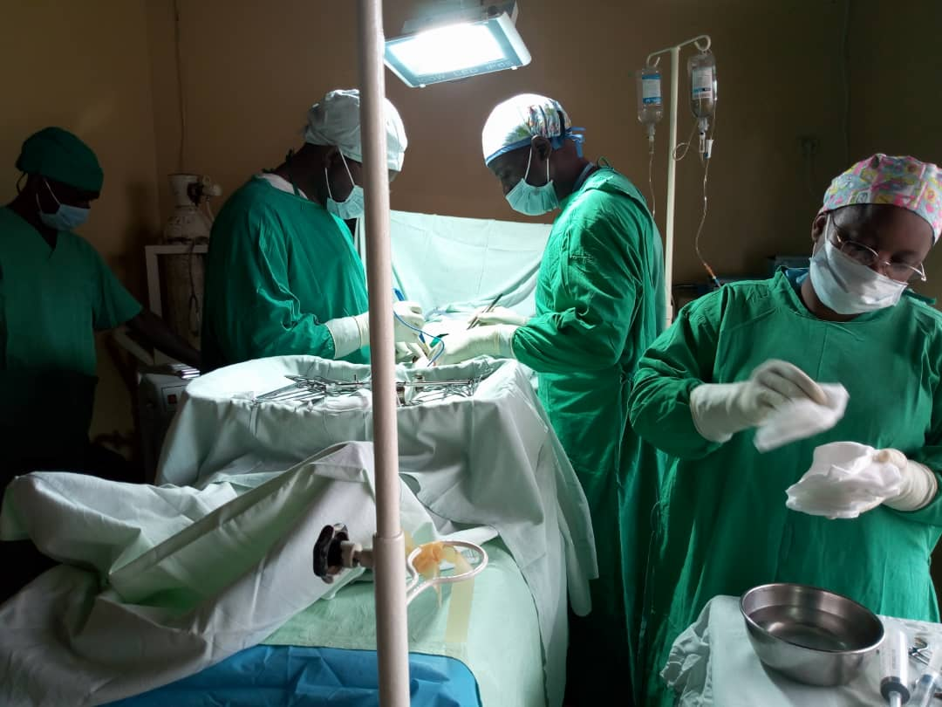
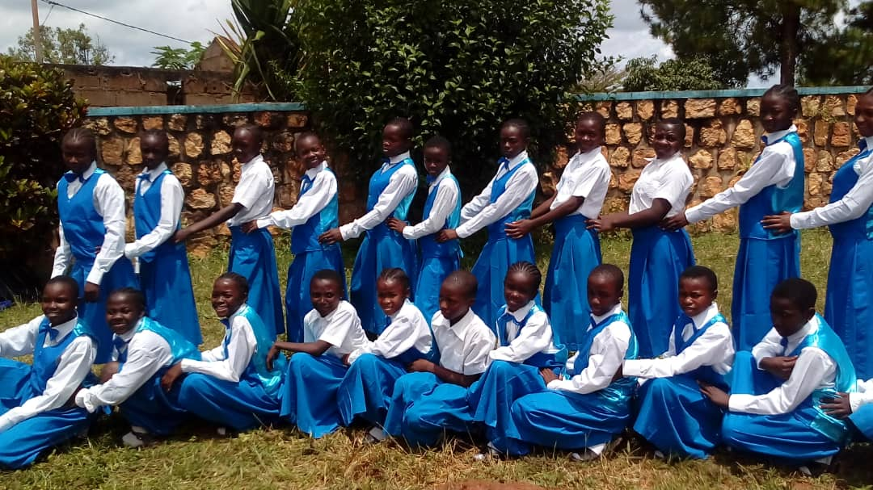
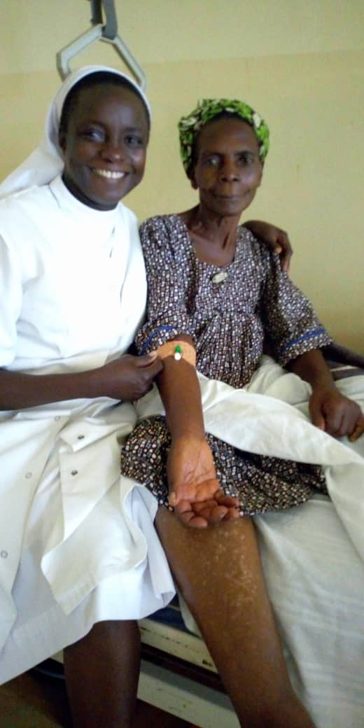
Some TSSF Activities

Slide 7
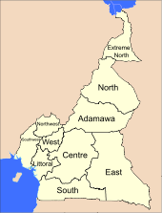
TSSF Health Services in Cameroon
North West
Shisong, Njinikom, Ntasen, Wum, Tatum, Djottin Bali, Bafut, Fuli Kom
South West
Mbetta and Akwaya
Littoral
Douala, Edea
West
Baham
Adamawa
Mayo Darle
North
Pitao
Far North
Dzigilao, Gobo
East
Doume- Abongmbang

Slide 8
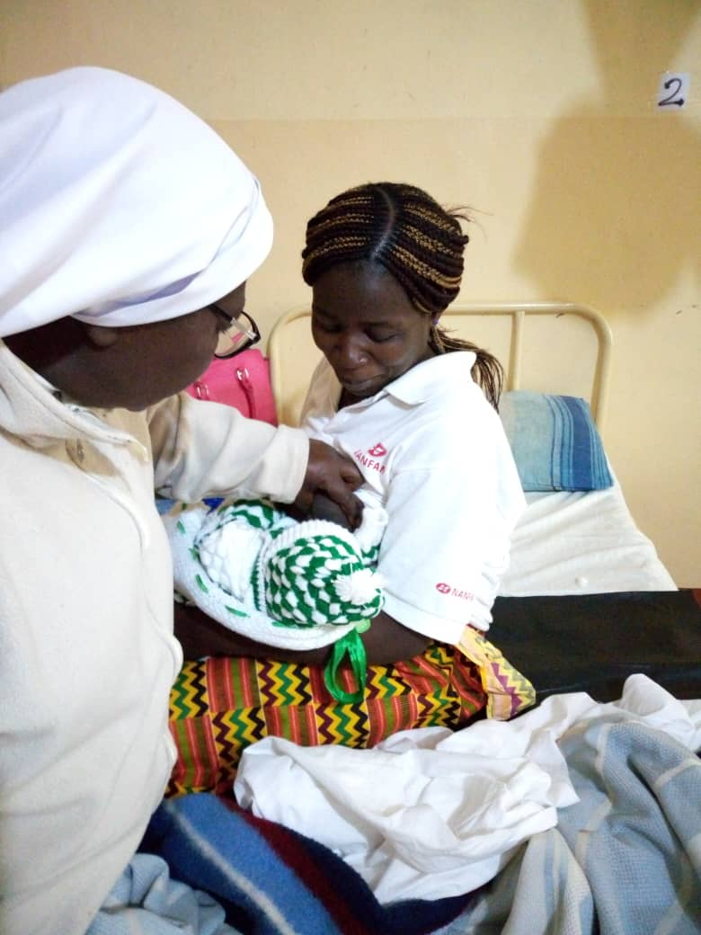
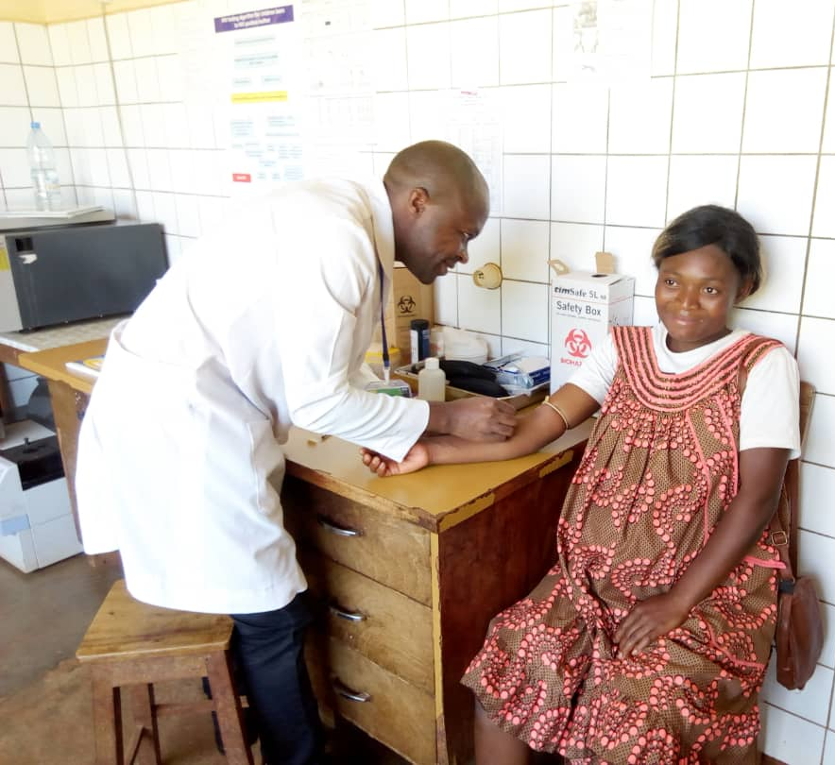
Spending time to care for all…

Slide 9
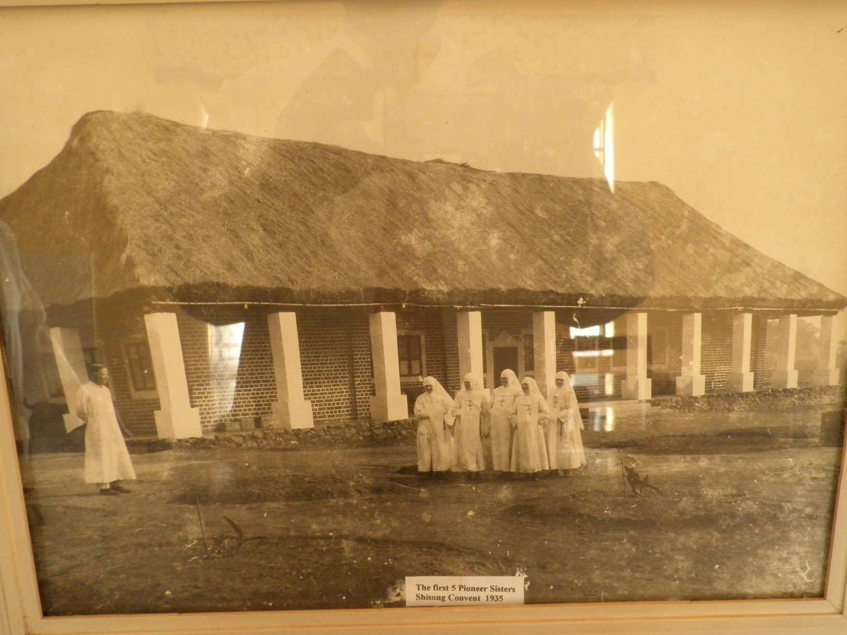
Shisong Hospital-the beginnings

Slide 10
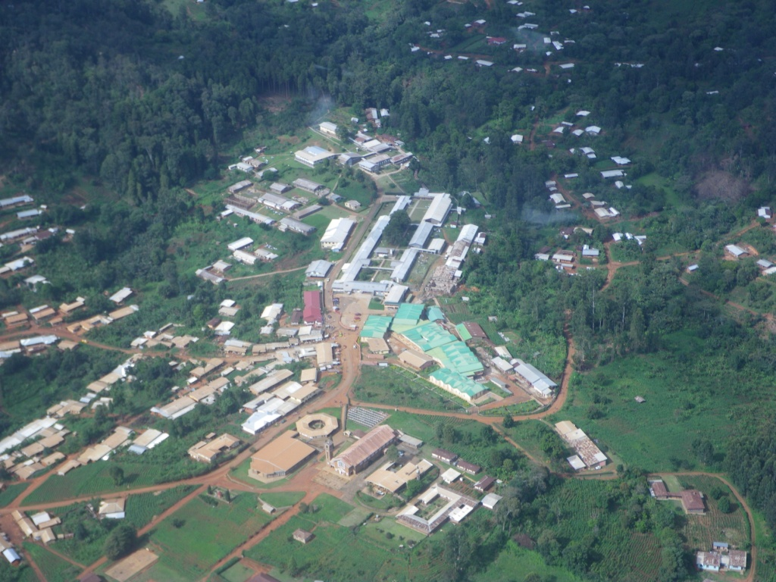
Shisong Hospital Cardiac Center

Slide 11
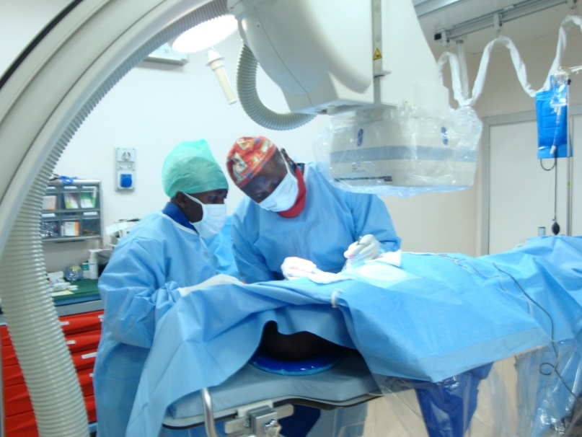
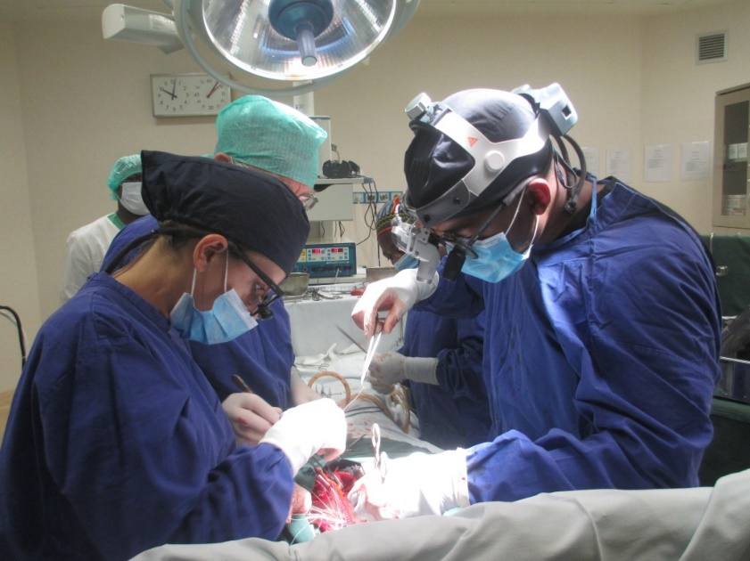
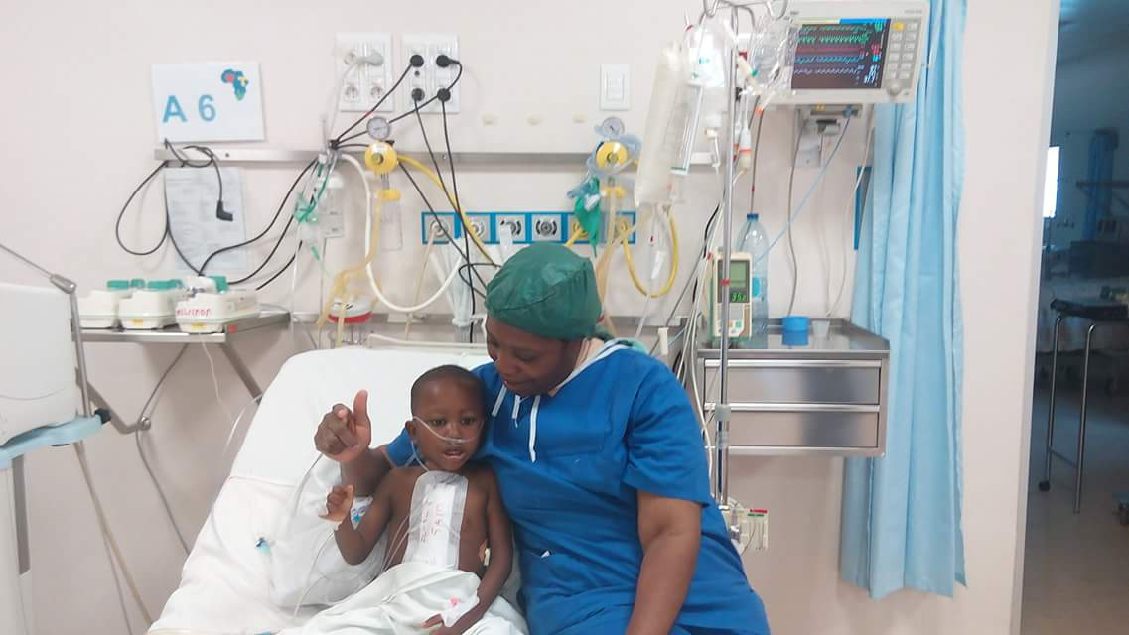
CARDIAC CENTER, Shisong
Consultation (onsite and outreach stations)
Cardiac surgery
Catheterisation
Pace maker implantation

Slide 12
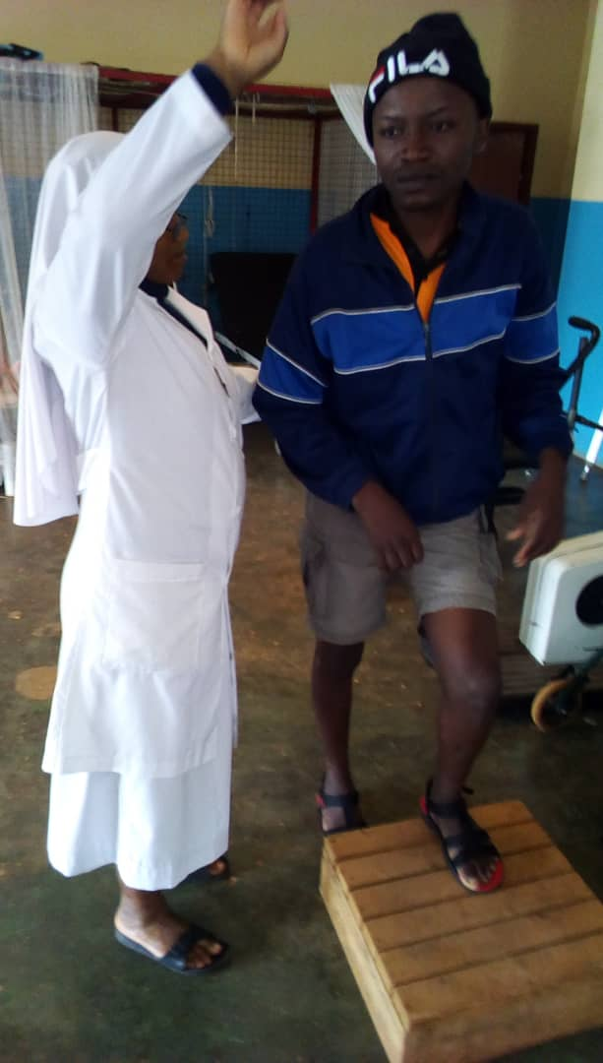
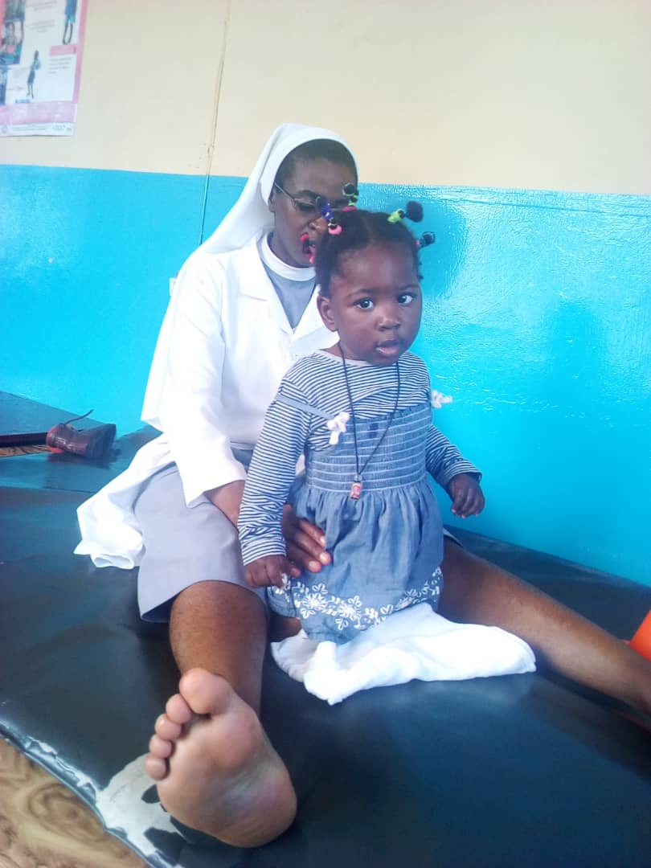
SAJOCAH—Persons with Physical Disabilities

Slide 13
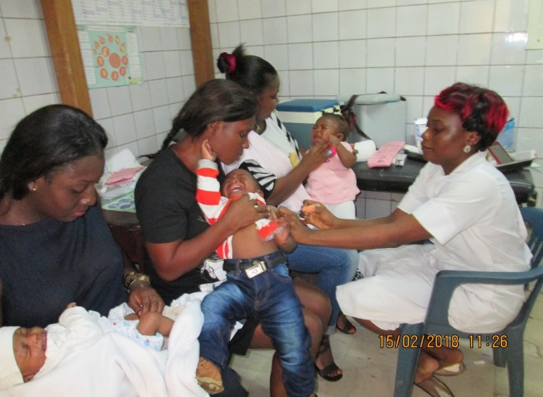
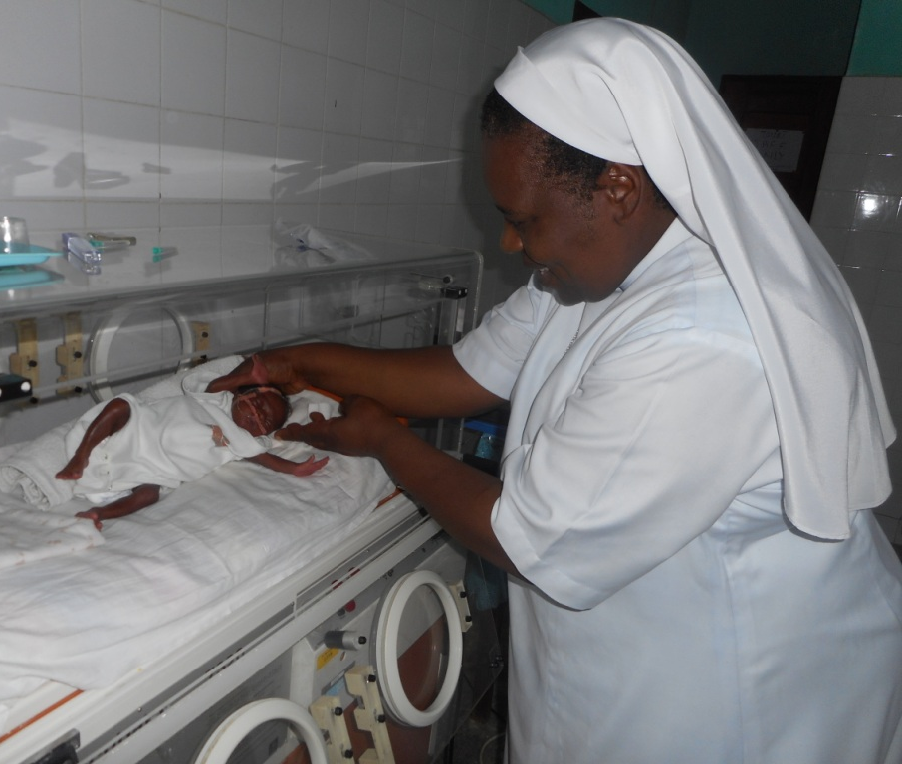
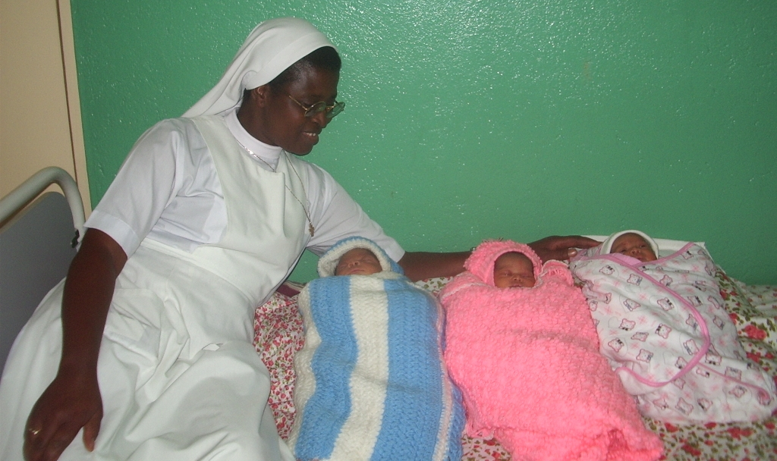
Mother and Child Programs
Immunization
Joy of Triplets-Shisong Hospital
8/8 premature babies survived in Edea this year

Slide 14
TSSF Strengths in Healthcare Delivery
African experience for over 80 years
Members who are professionals in healthcare
Large geographical coverage in Cameroon
Ability to maintain efficient local staff
Local and international development partners

Slide 15
Challenge of Healthcare in the TSSF System
Unavailable specialist for the suburbs
Inadequate or no Government subsidies
Lack of health insurance scheme in the Country
Low per capita income of citizens (1300 euro)
Clients are unable to pay their for their treatment; so who should pay?

Slide 16
Challenges in the TSSF Health Services
Procurement of medication and consumables: no such market in Cameroon
Maintenance of plants and medical equipment in Cameroon…
Specialized services tend to be unaffordable for the people.

Slide 17
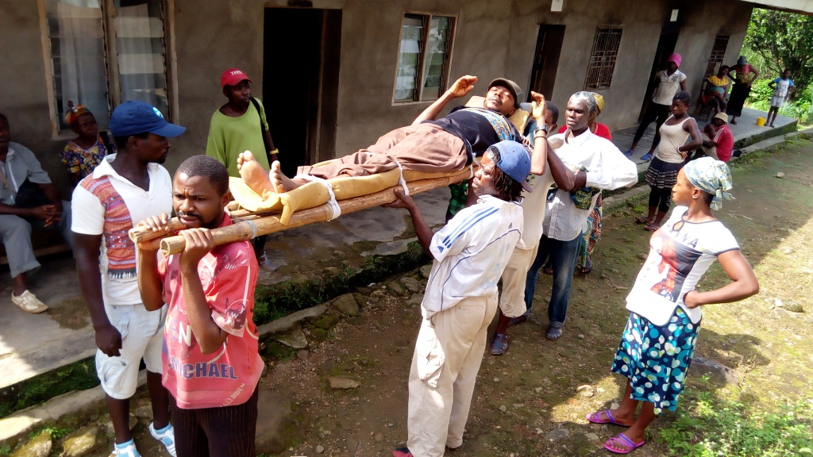
And Now the So Called “Anglophone Crisis”

Slide 18
Conclusion
Despite the challenges, the Tertiary Sisters affirm their determination to promote the health care of all irrespective of political leaning or economic strength. That is why, with international and local partners, we work hard to keep the service going even in the midst of the suppressive Anglophone crisis and other challenges.

